Slide 1
The Natural Water Cycle

Slide 3

Students will:
  Critically reflect on the significance of the natural water cycle to our planet.
  Understand how water moves through the water cycle.
  Identify the processes of the natural water cycle

Slide 4
How do you use water?

Slide 5
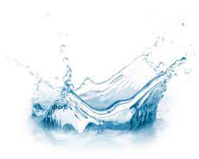
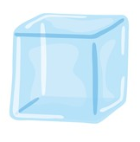
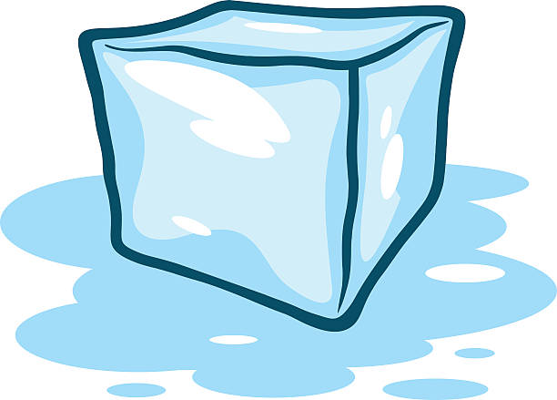
Can you pretend to be …
Water?
An ice cube?
A melting ice cube?
Steam?
Good job!
Nice one!
Not bad!
What great acting!
Water is water in liquid form. Duh!
When water gets really cold it becomes a solid.
When ice warms up it becomes a liquid again.
When water gets really hot it becomes steam, a gas.

Slide 6
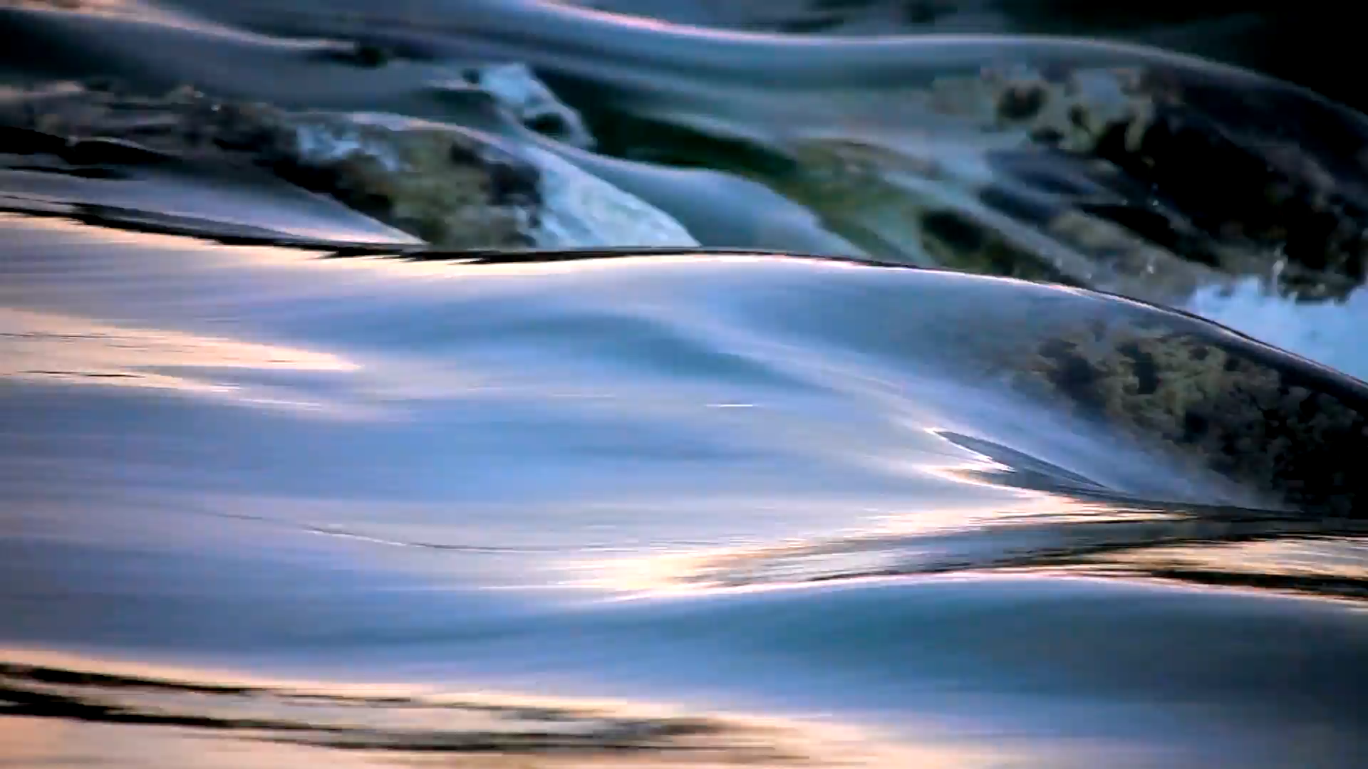
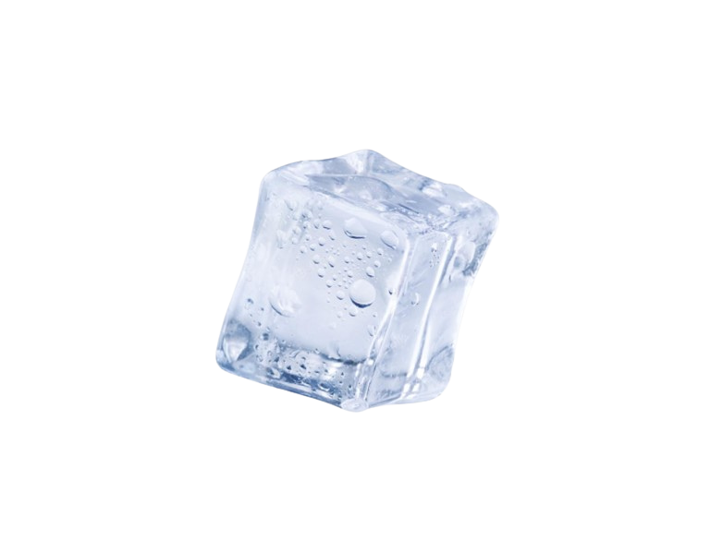
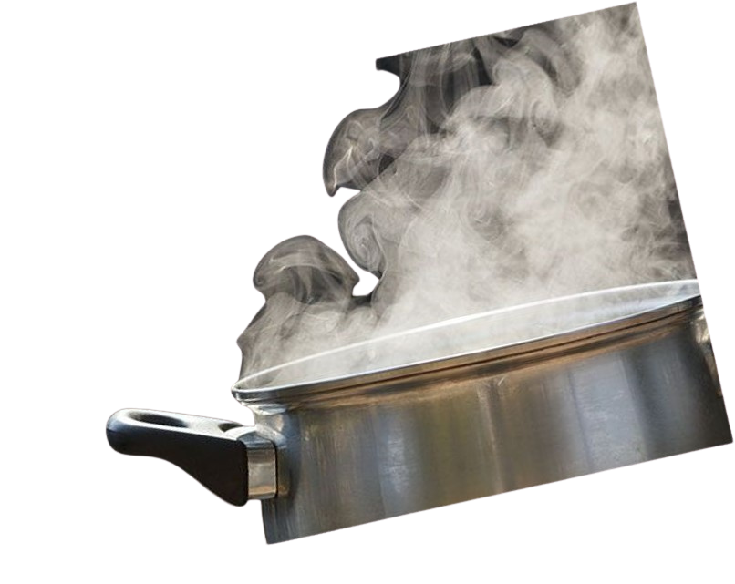
Does water change?
Water can change …
… but it is all still water!

Slide 7
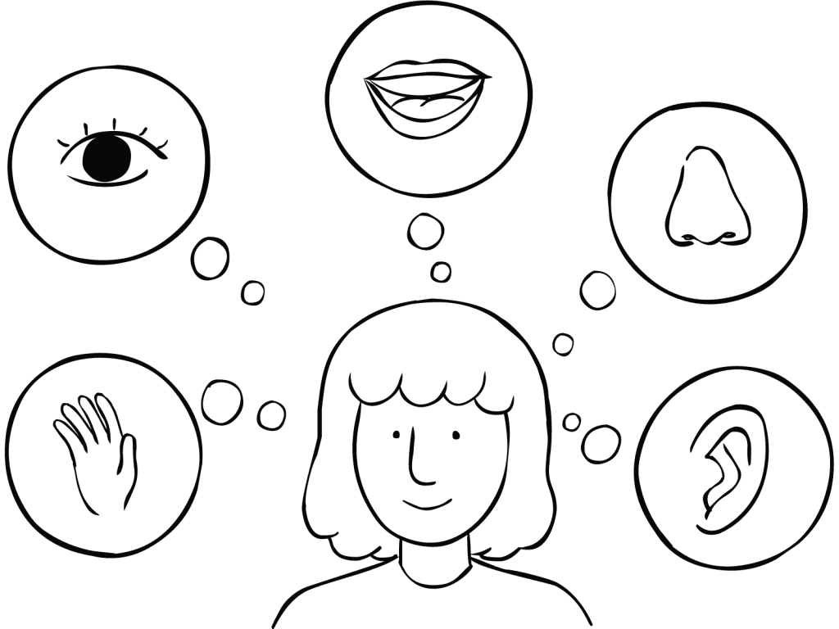
Using our senses
What are the five senses?
Let’s use our senses to think about what water is like.

Slide 8
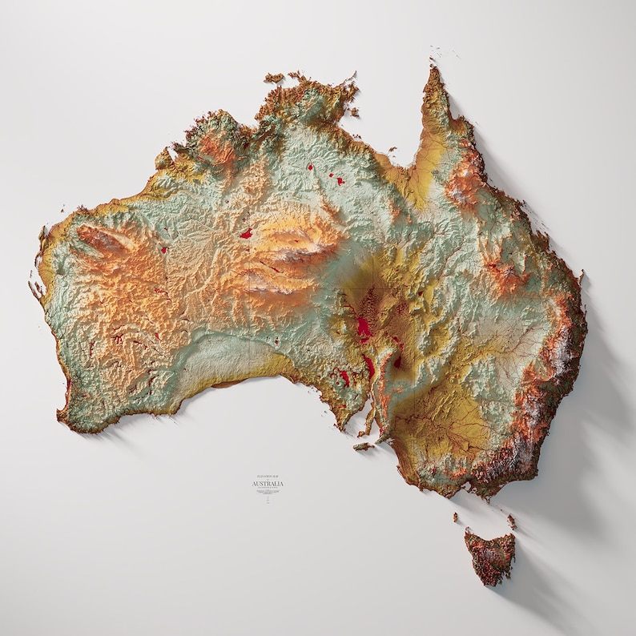
Where do we find water?

Slide 9
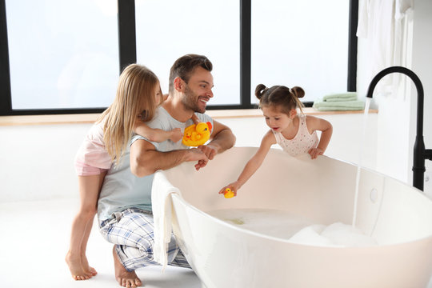
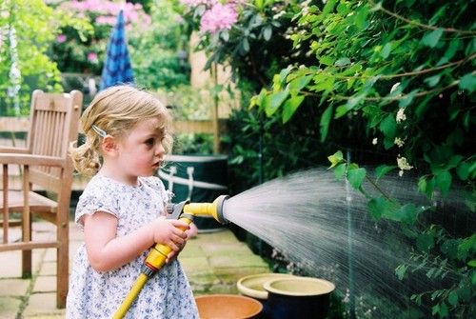
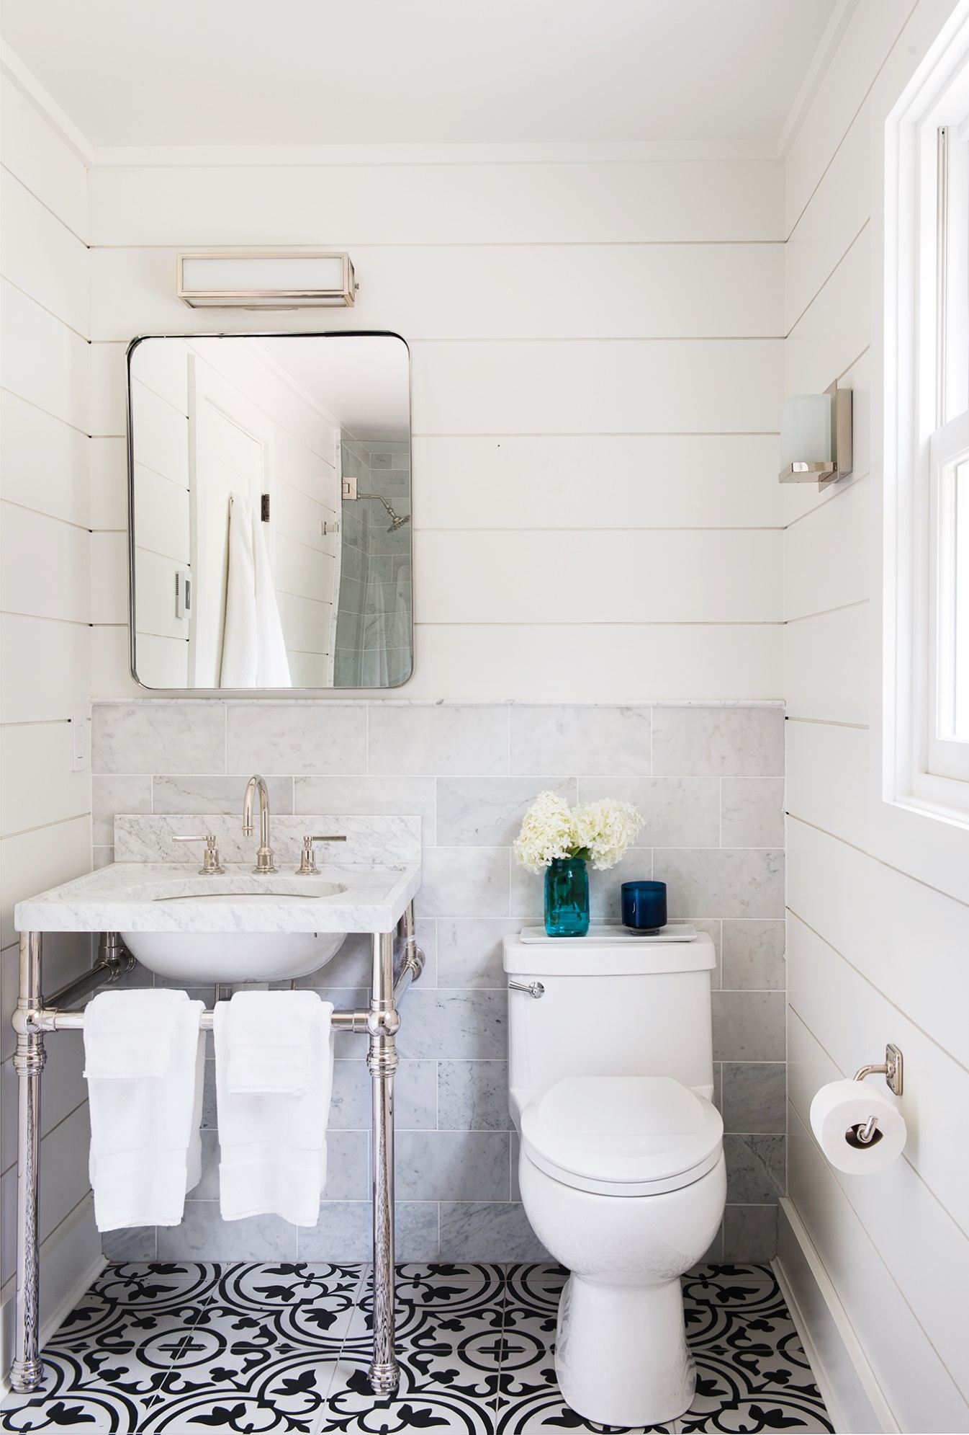
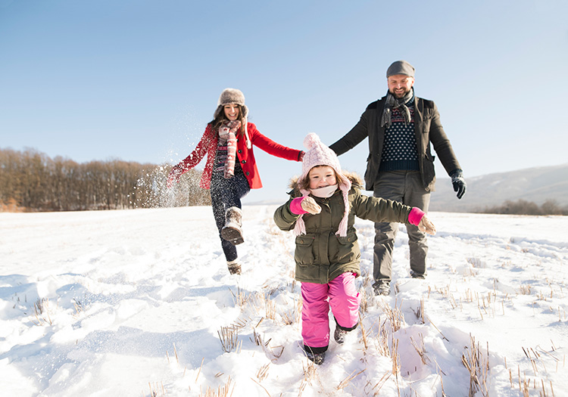
Where do we find water?

Slide 10
Big Questions
Does water disappear?
Is there ever new water?

Slide 11
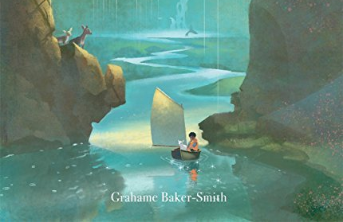
The Rhythm of the Rain
By Grahame Baker-Smith
While we read the story, THINK about our BIG questions! You might have an answer at the end.
Does water disappear?
Is there ever new water?

Slide 12
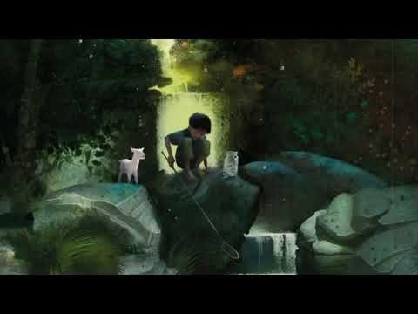

Slide 13
Big Questions
Does water disappear?
Is there ever new water?
No!
No!

Slide 14
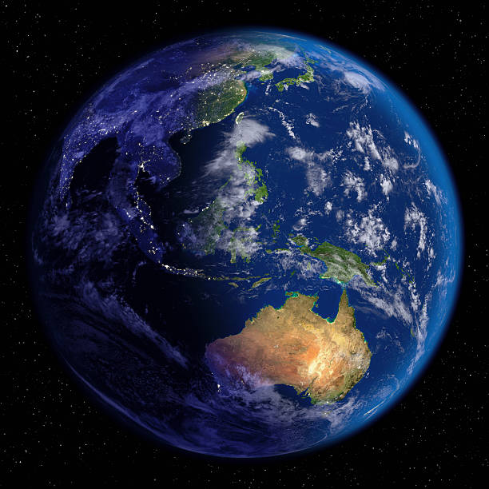
All the water we have is on Earth.
There is no more.

Slide 15
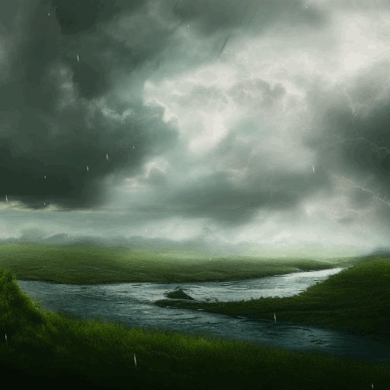
Water is constantly on the move.
It can be in lots of places.
We call this movement The Natural Water Cycle.

Slide 16
What are the parts of The Natural Water Cycle?
TASK:
Complete Part A and Part B as we discuss.

Slide 17
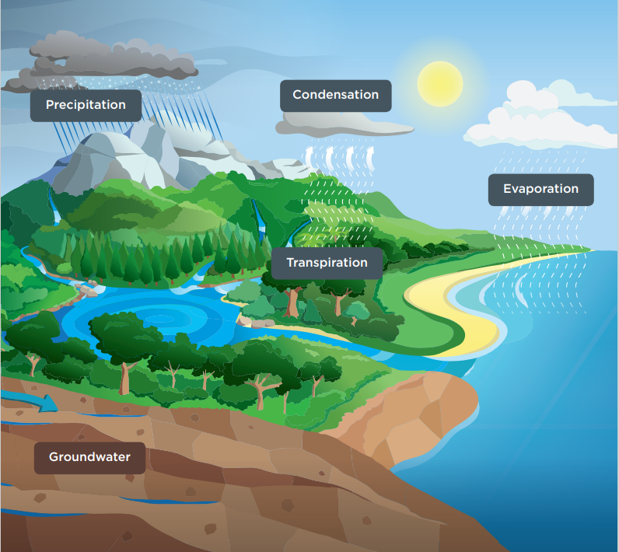
Evaporation
The sun heats water bodies across Earth, causing the liquid water to transform into water vapour.
The vapour (or gas) is light enough to rise into the atmosphere

Slide 18
Transpiration
Water is absorbed by a plants roots as a liquid, then travels up to its leaves before it is released as water vapour through the plant’s stomata into
the atmosphere.

Slide 19
Condensation
Water vapour rises into the air where the temperature becomes colder, and condenses
the water vapour into small droplets which form clouds.

Slide 20
Precipitation
When so much water has condensed in the clouds that the air cannot support its weight, water falls from the clouds as rain, hail, sleet or snow.
Much of this water flows across the land and collects in rivers, lakes and, eventually, the ocean.

Slide 21
Ground Water
Some of the water infiltrates into the ground and gathers in the cracks and pores of rocks, forming groundwater.
These areas of water-filled crevices are called aquifers.

Slide 22
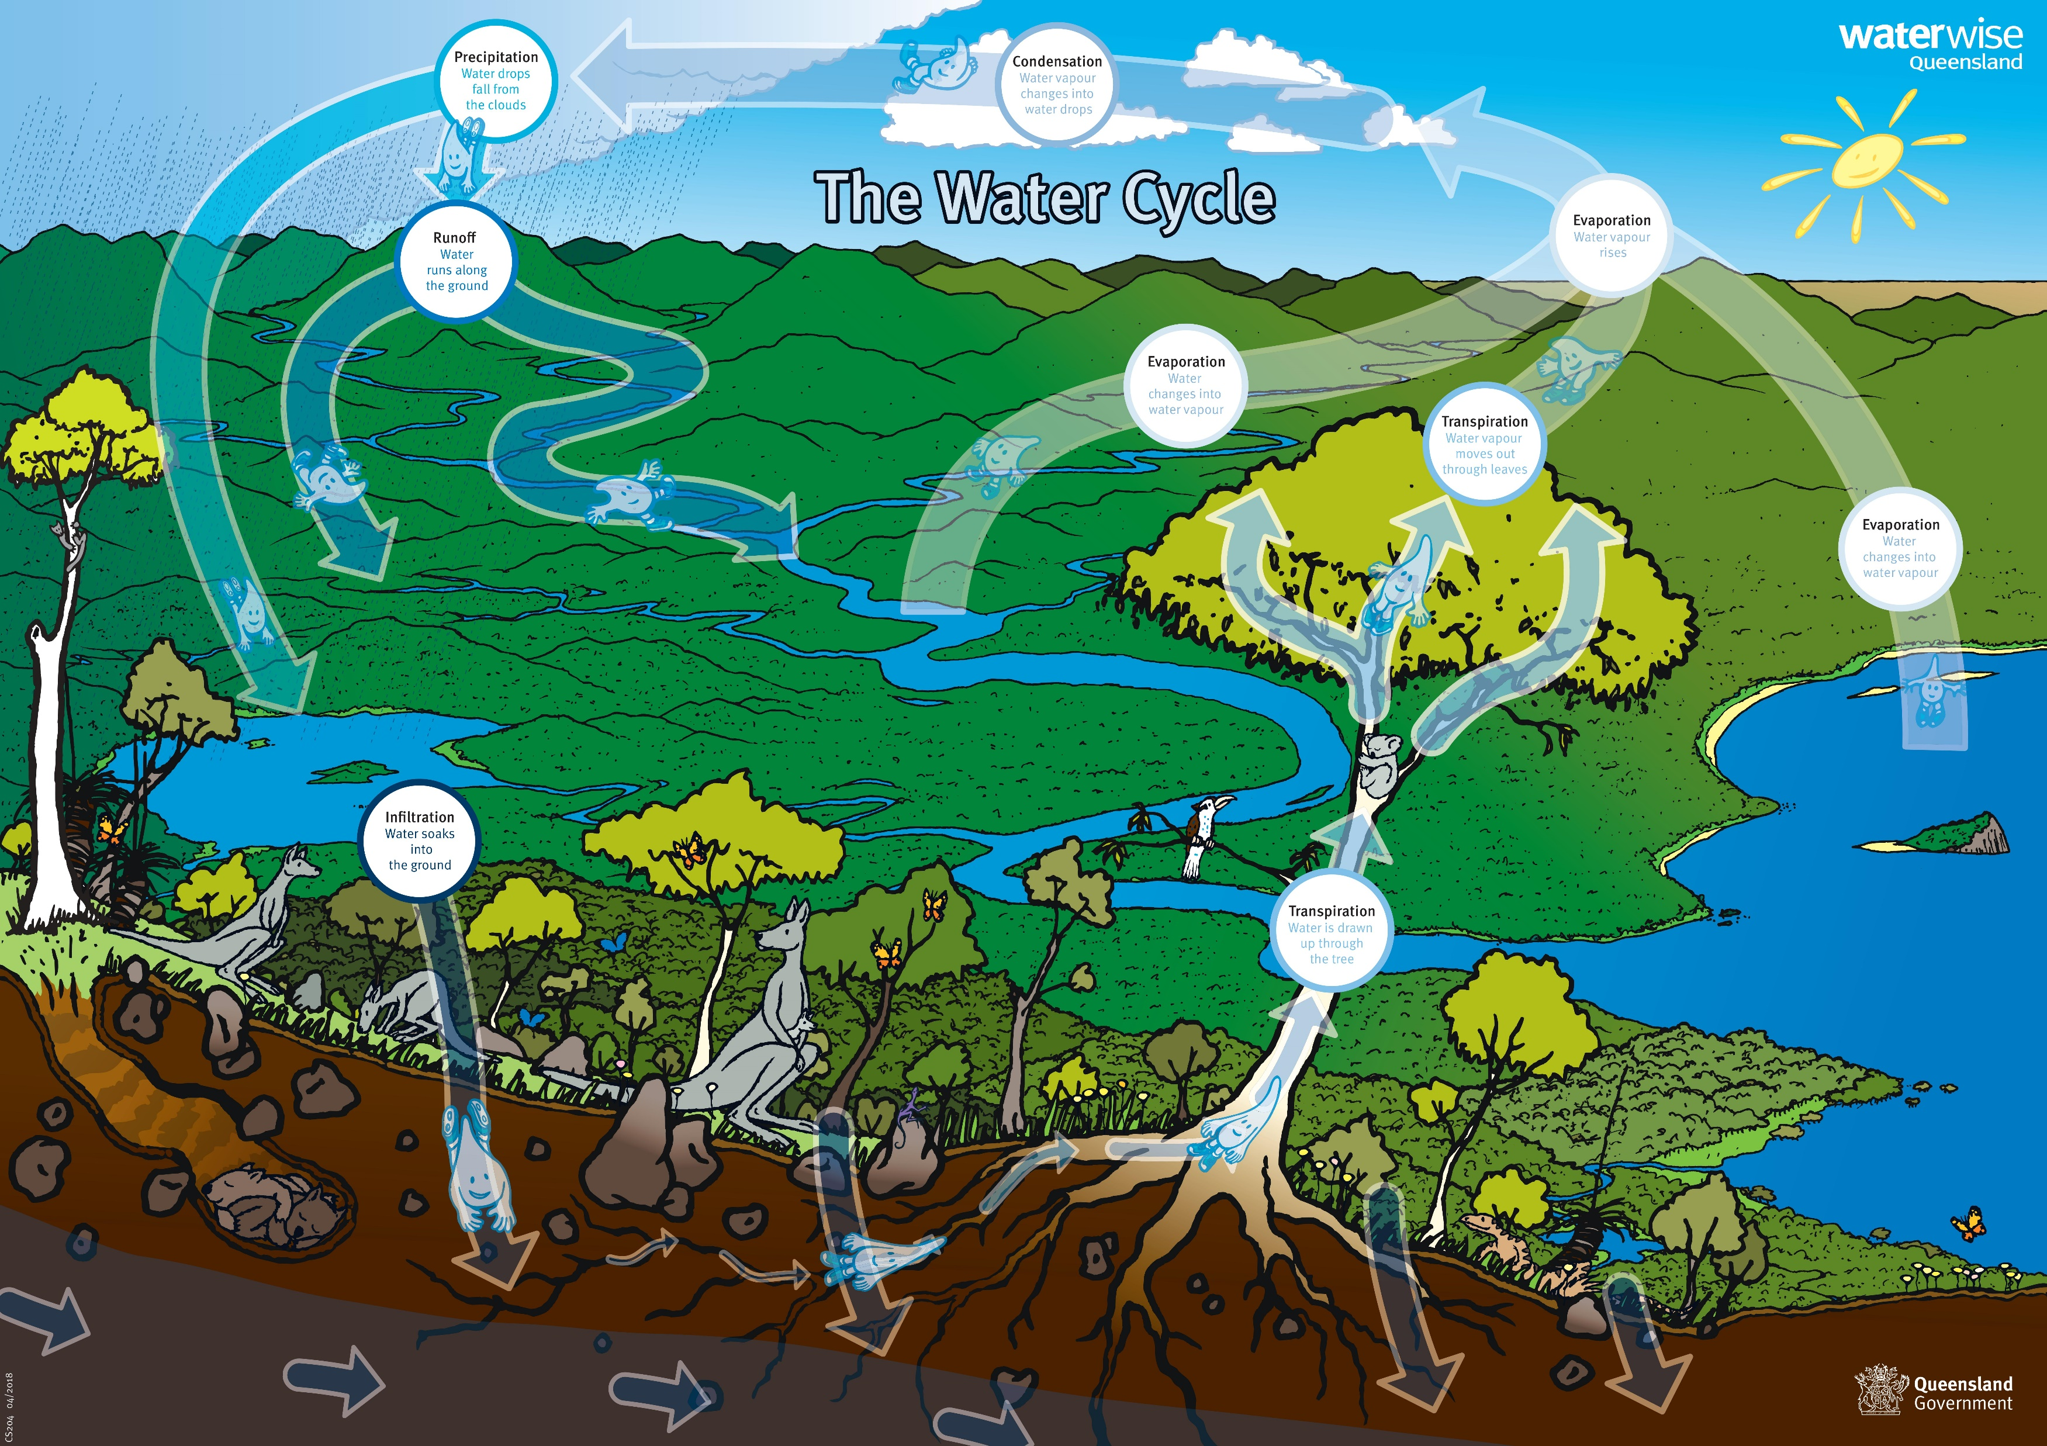

Slide 23
Let’s reflect
  At the start of the lesson we brainstormed for ‘water locations’ – let’s look at them again.
  Q: What parts of the water cycle are present in the water locations we thought about at the start of the lesson?
  Q: Some of these locations are in our home – does that mean we play a part in the Natural Water Cycle?

Slide 24
Water Cycle Pictionary!
I need FIVE volunteers!
Each answer will be a KEY WORD from today’s lesson.
Can our class volunteers guess them all within the time?

Slide 25

END
1
2
3
4
5
6
7
8
9
10
11
12
13
14
15
16
17
18
19
20
21
22
23
24
25
26
27
28
29
30
31
32
33
34
35
36
37
38
39
40
41
42
43
44
45
46
47
48
49
50
51
52
53
54
55
56
57
58
59
60

Slide 26
Question Time?

Slide 27
Extension
Water Cycle in a Jar
- Recreate the Water Cycle by making your own terrarium in this simple experiment.
- Refer to ‘Water Cycle in a Jar’ – Page 26-27 extracted from ‘Water. Learn it. Live it’ (Resource C)

Slide 28
Thank you!
The Natural Water Cycle

