Slide 1
Flushed

Slide 3

Students will learn:
  What sewage (wastewater) is and how it is treated before returning to the environment.
  Understand that sewage treatment is an essential service that we all need.
  To consider how we are all responsible for what goes ‘down the drain’.

Slide 4
How do you use water?

Slide 5
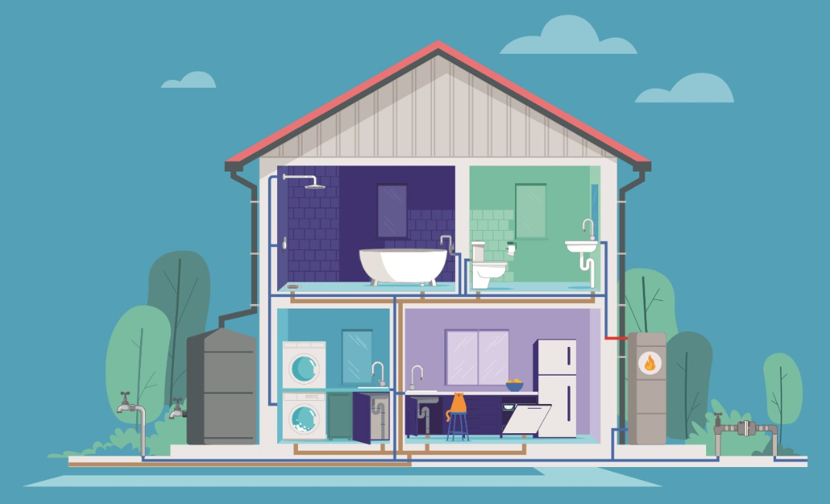
How do you use water?
Let’s think about how you use water at home, at school, or other places in your life.

Slide 7
What is wastewater?
Once we have used water, we create what is called wastewater, also called sewage.

Slide 8
We are going to hear about the story of a sewer pipe as it travels under our homes and businesses.
Activity:
Story of a Sewage Pipe
It will teach us about the things people put down the drain, some of which they shouldn’t!
You will play some of the characters.
As your character is named, come and tip out your jar into the water …

Slide 9



Story of a sewer pipe:
Our story begins
Mason
Hannah
Jessica
Jayden
Anika
Jayden
Oliver
YOU!

Slide 10
What have we learnt?
We use and pollute water in many ways – resulting in the need to clean it.
In modern towns and cities we create a lot of wastewater.
We need to clean this water to benefit both our health and the environment.

Slide 11
Something to reflect on
Local Traditional Owner perspective on water.
“Gatjin (water) is the lifeblood of our country. As gatjin moves through Djandak (Djaara Country): seeping into our soils, entering our groundwater, flowing down our waterways, and pooling in our wetlands, it shapes and nourishes our landscape. It is integral to the health of our People and our Country”
From Dhelkunyangu Gatjin Working together to heal water

Slide 12
How do we treat (clean) wastewater?

Slide 13
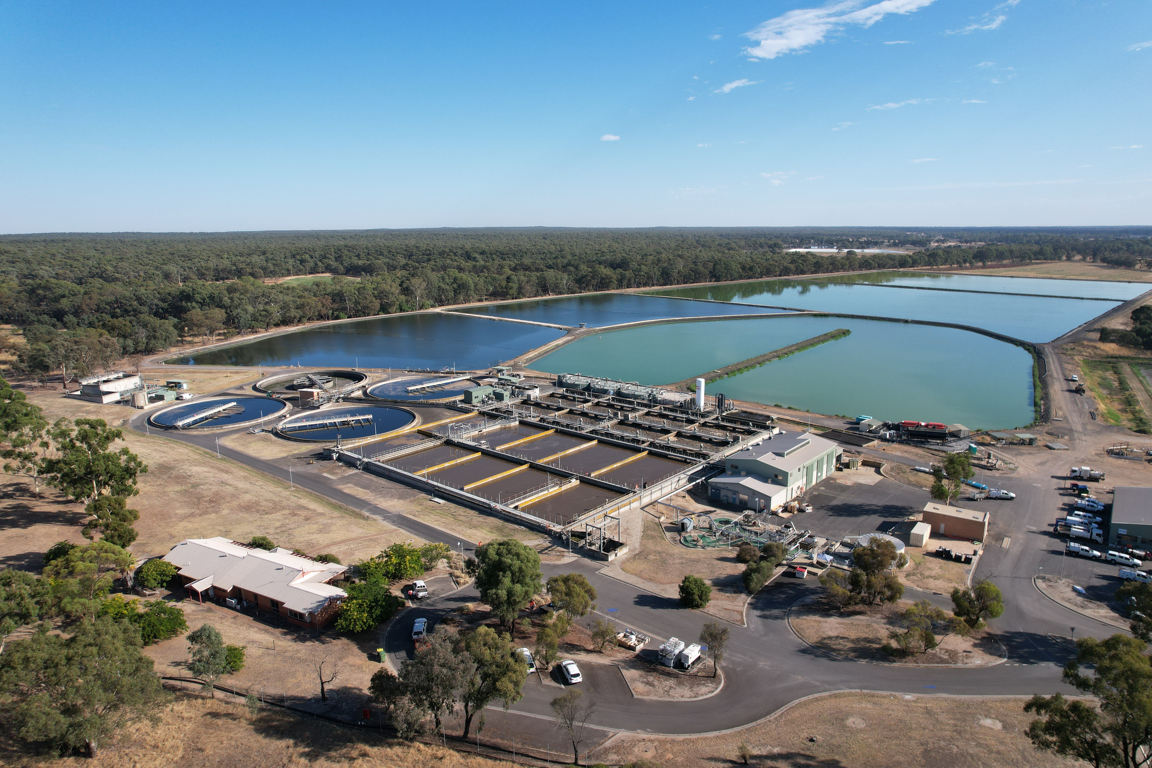
Using Epsom Water Reclamation Plant as an example, we will build an understanding of how our wastewater is treated.

Slide 14
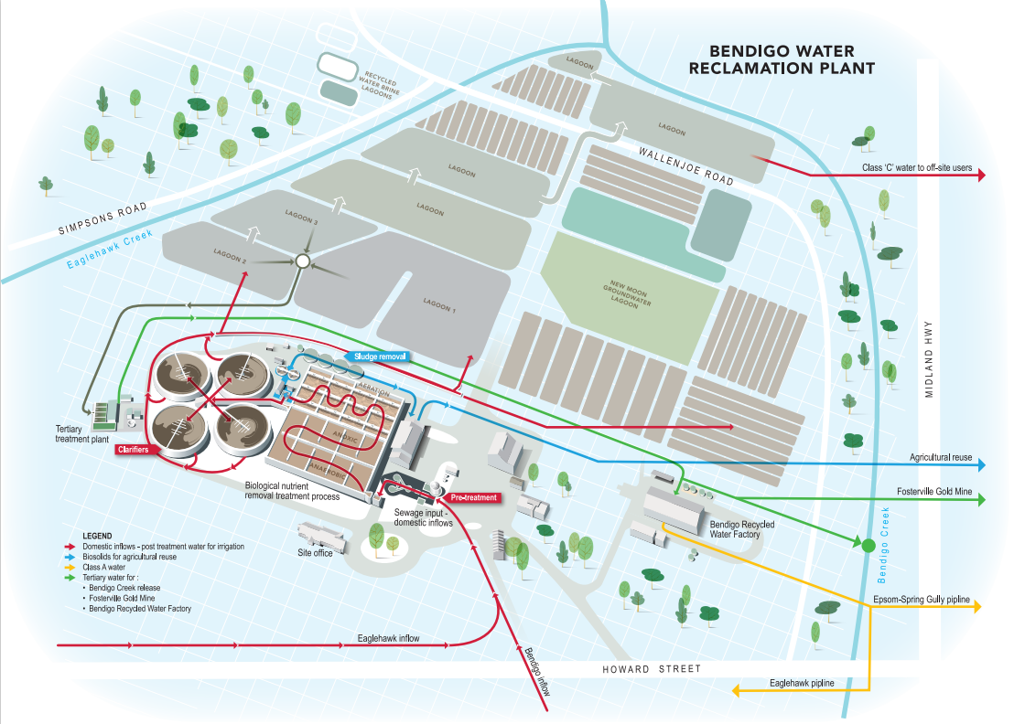
How the plant operates:
Raw Sewage.
First, 22 megalitres (about 9 swimming pools worth!) per day of wastewater enters the plant. 99% of this is just water.
Filter the big stuff.
We filter out things like wet wipes, Nan’s false teeth, tennis balls etc.
We also need to get out the fat balls!

Slide 15
How the plant operates:
Bacteria, not chemicals.
Bacteria or ‘bugs’ eat all the nutrients: things we don’t want in the waterways like nitrogen and phosphorus.
Take out the ‘solids’.
We remove all the sludge and turn it into biosolids for farms. This has lots of goodies that can help grow crops.
UV and sunlight.
We use UV light from the sun and machines to kill bad bacteria like E.coli.

Slide 16
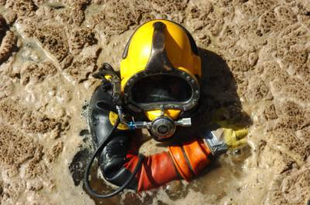
How’s this for a job?

Slide 17
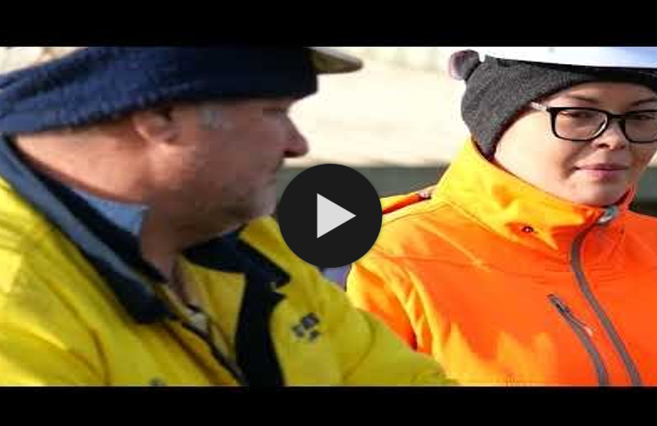
Let’s see some of the plant action.
Divers at Bendigo Water Reclamation Plant

Slide 18
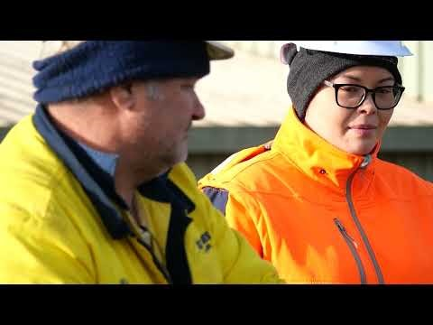

Slide 19
What did we do in the past?

Slide 20
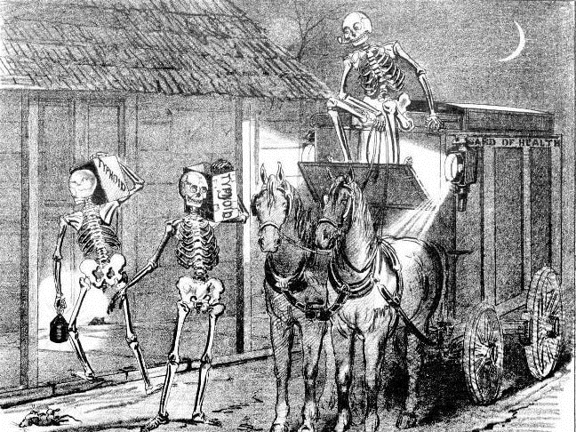
Activity: reflecting on the history of sewage in Australia.
TASK: in your group.
- Discuss what is happening in the image.
- Think about how this might relate to the history of wastewater treatment in Australia.
- Be prepared to report back to the class!

Slide 21
What did we do in the past?
Resource A
- In the early days of colonial Australia we had ‘nightmen’ who collected our ‘night soil’ (poo and wee).
- This dangerous (and stinky) job was meant to keep cities safe from diseases like cholera, dysentery and typhoid, by moving our waste to the outskirts of town before sewerage pipes did the waste removal for us.
- In this cartoon the nightmen are being shown as spreading disease - which is a bit unfair!

Slide 22
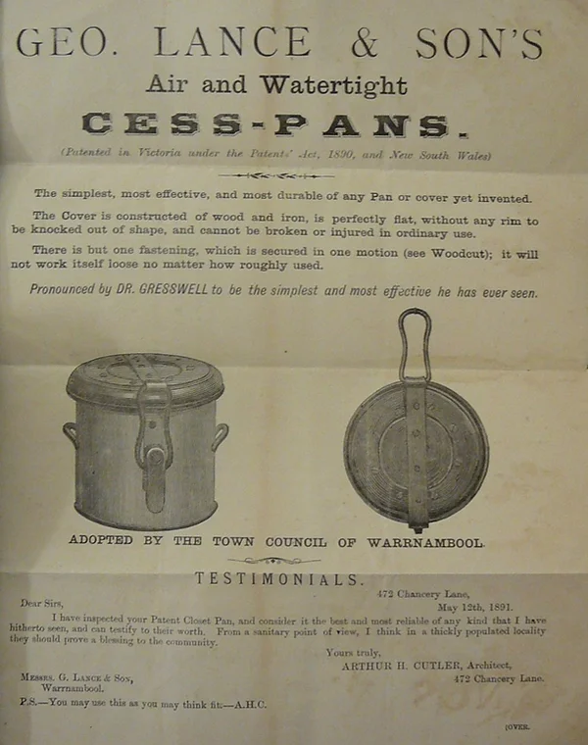
What did we do in the past?
Resource B
- Before sewerage pipes took sewage away from our homes, people went to the toilet in cess-pans. These were collected by the ‘nightman’ and thrown into big lined holes called cesspits.
- These cesspits often leaked, polluting the water supply and environment.
- You would certainly want your cess-pan to be air and watertight…!

Slide 23
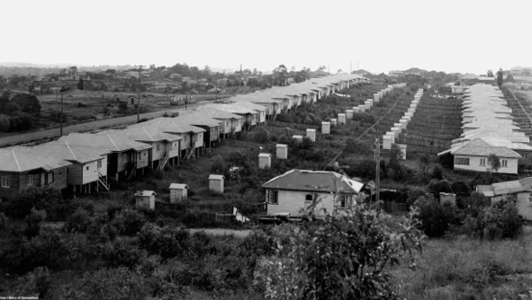
What did we do in the past?
Resource C
- If you lived outside of a major city centre in Australia, you likely had an outhouse in your back yard.
- This was the case right up to the e
early 1970s in some cases.
- Again, it was someone’s job to collect the waste at night.

Slide 24
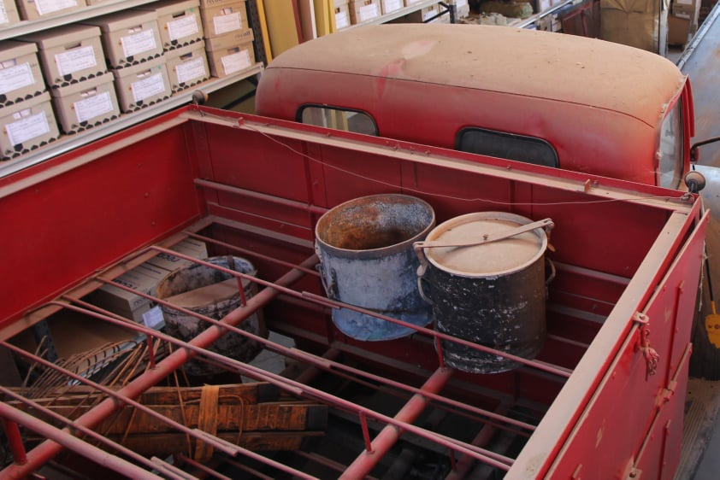
What did we do in the past?
Resource D
- This is an actual ‘nightsoil’ truck from Bendigo.
- You can see in the back the place where the cess-pans would go.
- You wouldn’t want to drive this around a corner too fast…

Slide 25
In the past we didn’t deal with our wastewater properly, this resulted in poor health, disease, and a very polluted environment.
What have we learnt?

Slide 26
A. We all create wastewater. True or False?
B. We should only flush pee, poo and toilet paper. True or False?
Quick Quiz
C. Wet wipes can be flushed down the toilet. True or False?
D. In colonial Victoria, lots of people got sick from untreated wastewater. True or False?
E. Wastewater that goes to the reclamation plant is 1% water? True or False?
F .We have always had pipes taking sewage away from our houses? True or False?
G .We use UV light to help treat wastewater? True or False?
H. Poo diver isn’t a real job? True or False?

Slide 27
A. We all create wastewater. True or False?
True
B. We should only flush pee, poo and toilet paper. True or False?
Quick Quiz
Answers
True
C. Wet wipes can be flushed down the toilet. True or False?
False
D. In colonial Victoria, lots of people got sick from untreated wastewater. True or False?
True
E. Wastewater that goes to the reclamation plant is 1% water? True or False?
False – it is 99% water.
F .We have always had pipes taking sewage away from our houses? True or False?
False
G .We use UV light to help treat wastewater? True or False?
True
H. Poo diver isn’t a real job? True or False?
False – it is a real job!

Slide 28
Did you learn something?
  I know what sewage (wastewater) is.
  I know how wastewater is treated before it returns to the environment.
  I understand that sewage (wastewater) treatment is an essential service that we all need.
  I know that we are all responsible for what goes ‘down the drain’.

Slide 29
A reminder:
Local Traditional Owner perspective on water.
“Gatjin (water) is the lifeblood of our country. As gatjin moves through Djandak (Djaara Country): seeping into our soils, entering our groundwater, flowing down our waterways, and pooling in our wetlands, it shapes and nourishes our landscape. It is integral to the health of our People and our Country”
From Dhelkunyangu Gatjin Working together to heal water

Slide 30
Question Time?

Slide 31
Thank you!
Flushed!

