Slide 1
Our Precious Water

Slide 3

Students will learn:
  Understand that fresh, accessible water is rare and precious.
  Know the key features of the urban water cycle.
  Understand that sustainable water usage is essential.

Slide 4
How much water is there?

Slide 5
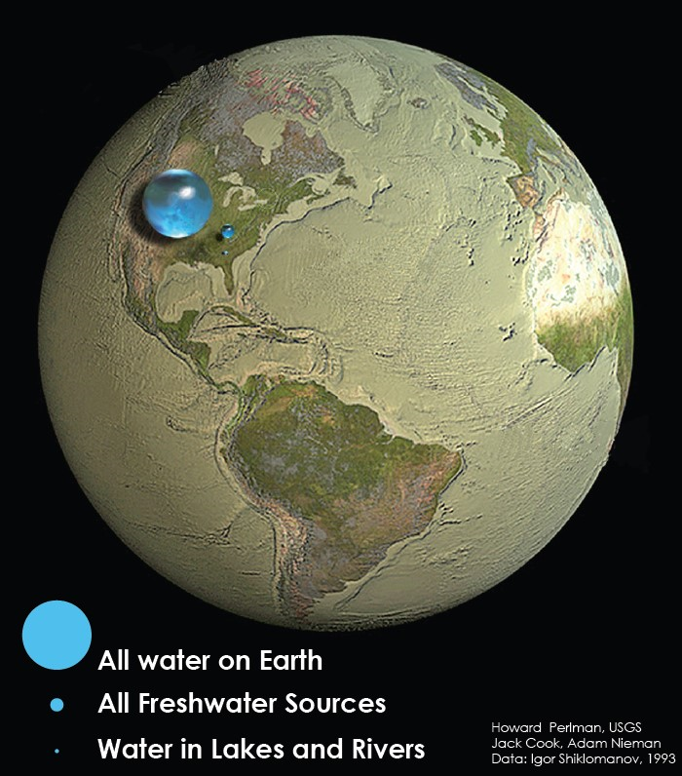



Our bucket is all the water on earth, which is mainly saltwater.
Our glass is all the fresh water on earth, which is mainly ‘locked up’ in glaciers and underground.
Our drop is the surface water we can access from lakes and rivers.

Slide 6
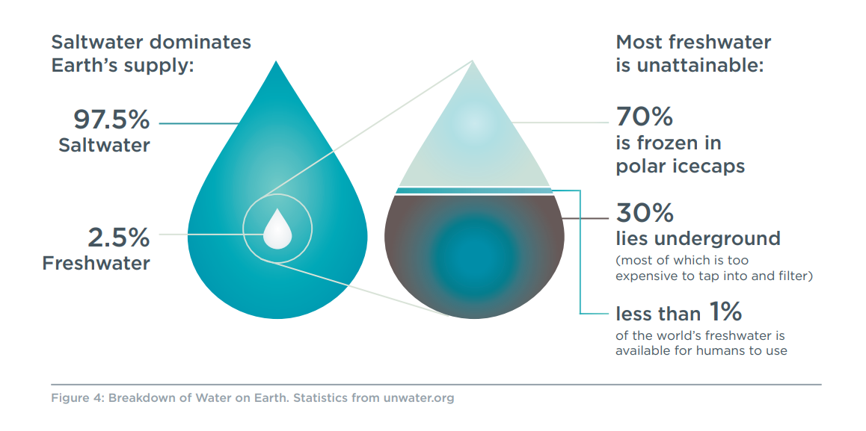

Slide 7
How would you finish this sentence?
“Water is precious because …”
We know that water is rare – but why else is it precious?
Think, Pair, Share.
Precious means: has great value; not to be wasted or treated carelessly.

Slide 8
Water is precious because …
- Our bodies need it to survive!
- All animals and plants depend on fresh water.
- Our industry (places that have jobs) use it.
- We can’t grow food without it.
- It keeps us clean and healthy.
We can’t live without water – it’s as simple as that.

Slide 9
Something to reflect on
Local Traditional Owner perspective on water.
“Gatjin (water) is the lifeblood of our country. As gatjin moves through Djandak (Djaara Country): seeping into our soils, entering our groundwater, flowing down our waterways, and pooling in our wetlands, it shapes and nourishes our landscape. It is integral to the health of our People and our Country”
From Dhelkunyangu Gatjin Working together to heal water

Slide 10
What is the Urban Water Cycle?

Slide 11
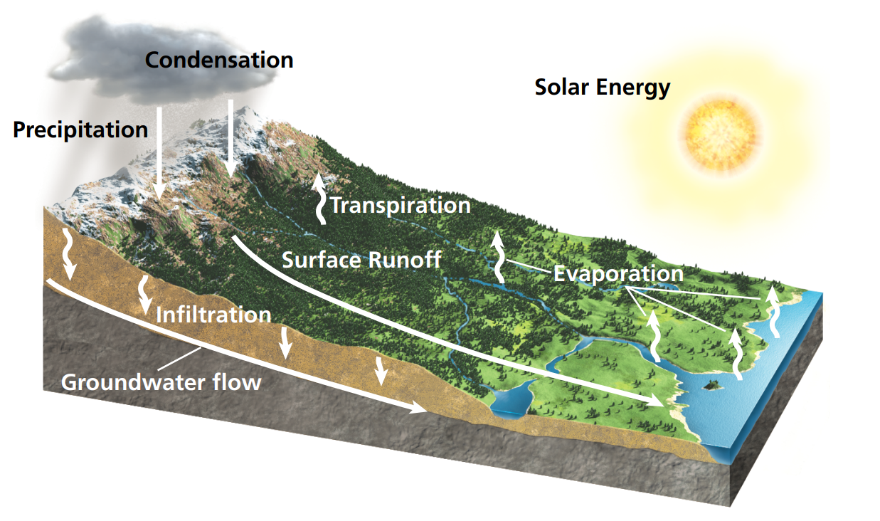
The Natural Water Cycle
Water is constantly on the move on our planet.
This is the natural state without human intervention.
When human populations were small, fresh water was easily accessible, and rarely polluted.

Slide 12
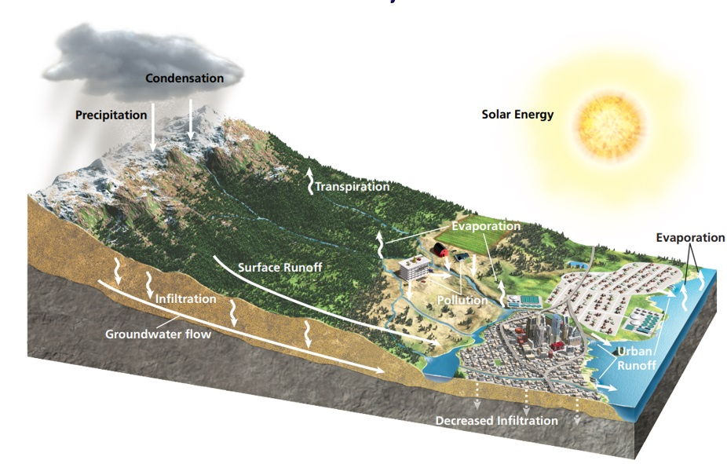
The Natural Water Cycle:
When we began to build cities we interrupted the water cycle.
How have we changed the Natural Water Cycle?
We capture water in reservoirs.
We direct storm water.
We create waste water and pollution.
We also remove trees and plants for agriculture and industry.

Slide 13
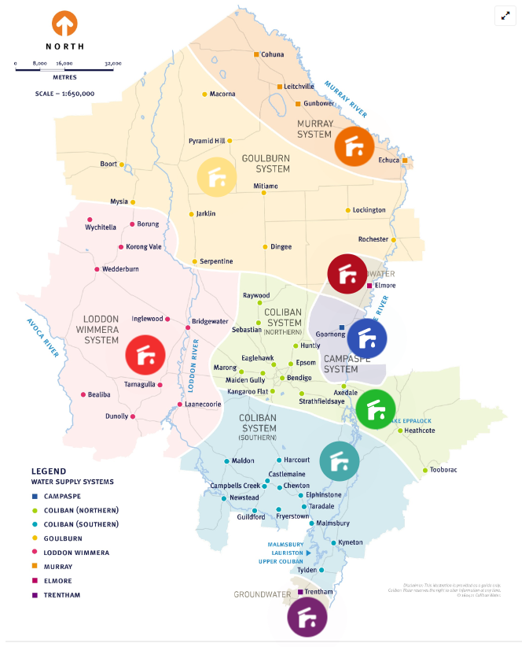
Where does your water come from?
Find out here

Slide 14
A Changing Climate

Slide 15
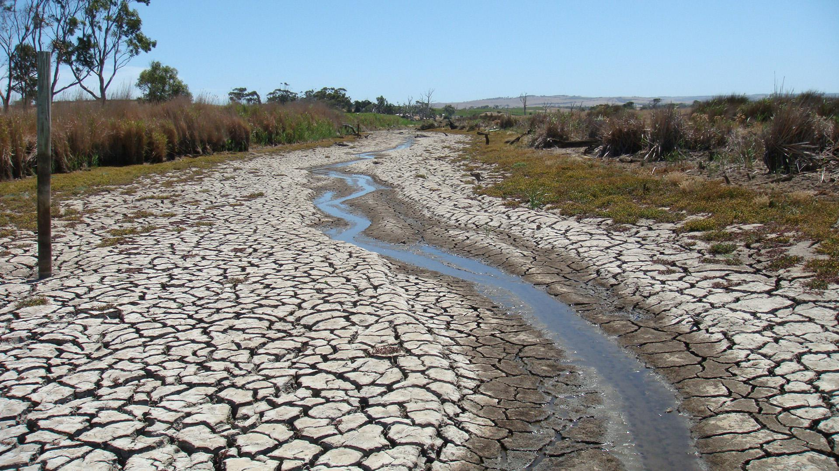
What do we know about the future?
Our climate is changing, which means:
- less reliable rain fall;
- hotter, dryer summers;
- we may experience extended periods of low rainfall – this is called a drought.
- we had our worst drought recently, from 2001-2009. This was called the Millennium Drought. Which devastated communities, industries and the environment.
Our population is increasing.
We will want to maintain the way we live, which means:
- drinking water;
- a good environment;
- nice parks and gardens;
- and water for farmers.

Slide 16
What would you choose? Activity: Water Use Tournament
Instructions
You are playing the role of a Community Advisory Group member.
These groups give Coliban Water advice.
You should imagine our region is entering an extended drought.
Be ready to share your answers!
What advice will you give Coliban Water?
How should water be allocated?
What areas should we choose to prioritise over others?
Use the tournament bracket to decide by selecting one water use over another until you have your number one priority.

Slide 17
Water needs to be sustainably managed for the future of our region.
This means:
- Conserving water in our homes and businesses.
- Reducing the need for water with smart gardens and efficient appliances.
- Recycling water for irrigation and parks and gardens.
- Protecting our water ways and catchments.
We need to use water sustainably – it’s as simple as that.

Slide 18
Can you answer these questions?
Why is water so precious?
What are three things that make up the urban water cycle?
Will we always have reliable rainfall in the future?

Slide 19
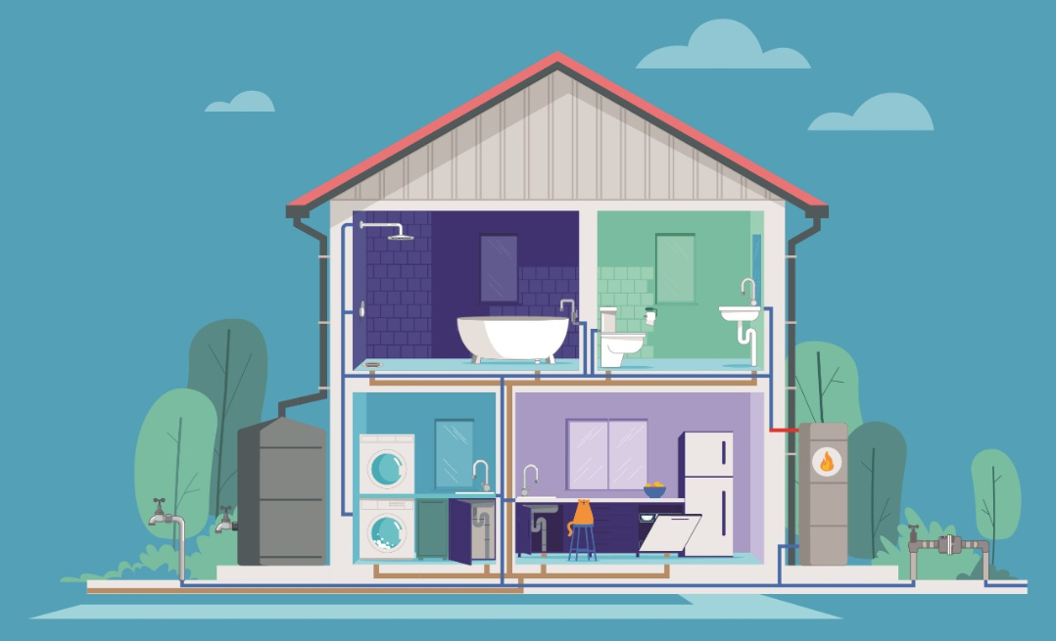
How can we save water?
Think about how you use water at home, at school or other places.

Slide 21
Question Time?

Slide 22
Thank you!
Our Precious Water

