Slide 1
Flushed

Slide 3

Students will learn:
  What sewage (wastewater) is.
  That we need to protect our sewage pipes.

Slide 4
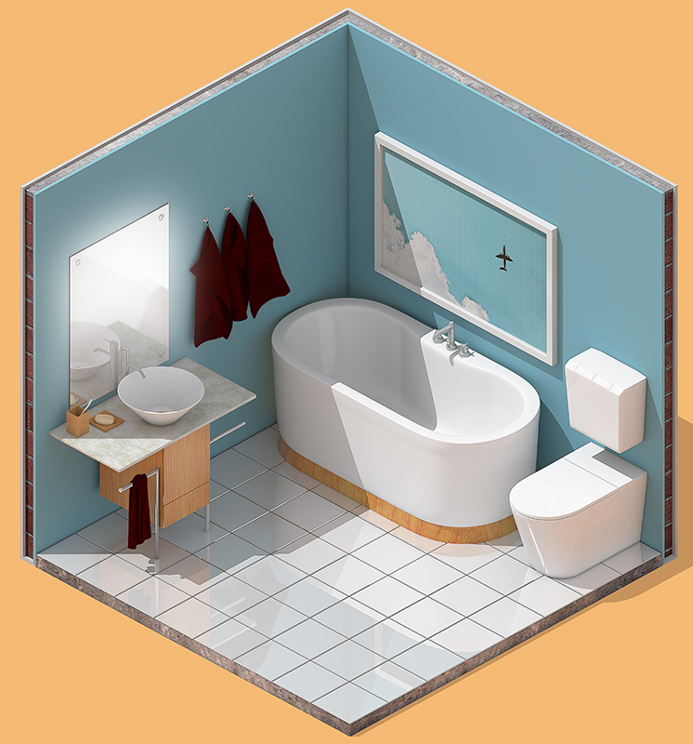
What happens when we flush the toilet?
What happens when you pull the plug out of the sink?
Where does the bath water go?

Slide 5
What is wastewater?
Once we have used water, we create what is called wastewater, also called sewage.

Slide 6
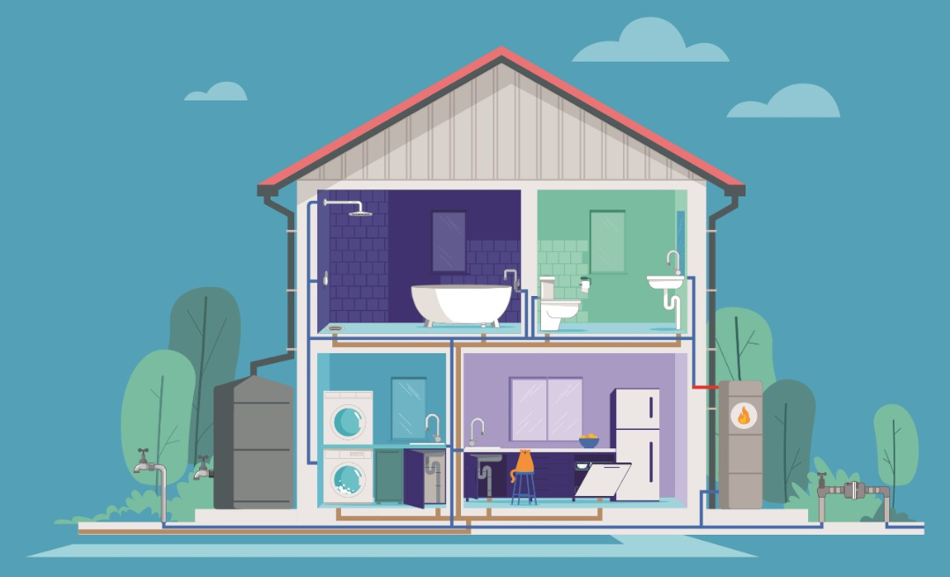
What is wastewater?
Where would you make wastewater at your house?
…have a SHOWER
…go to the TOILET
…empty your BATH
…wash your hands in the SINK
…use the WASHING MACHINE
…use the DISHWASHER

Slide 7
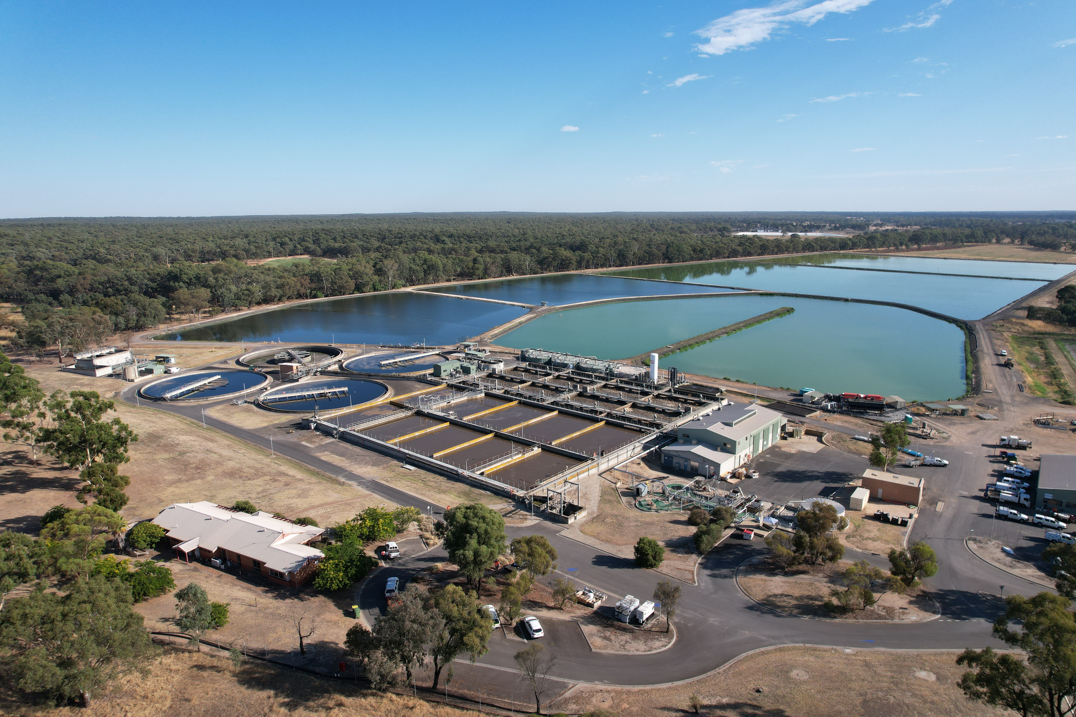
All wastewater ends up at a Water Reclamation Plant.
Here it is cleaned and then returned to environment.

Slide 8
We are going to hear about the story of a sewer pipe as it travels under our homes and businesses.
Activity:
Story of a Sewage Pipe
It will teach us about the things people put down the drain, some of which they shouldn’t!
You will play some of the characters.
As your character is named, come and tip out your jar into the water …

Slide 9



Story of a sewer pipe:
Our story begins
Mason
Hannah
Jessica
Jayden
Anika
Jayden
Oliver
YOU!

Slide 10
What can you do?
Only flush the three P’s –
Pee, Poo, and Toilet Paper.
Make sure wet wipes, cotton buds, tissues, and paper towels go in the bin, NOT the toilet.
Don’t put oil or fat down the drain.
Scrape off food scraps before you do the dishes.
Don’t put any rubbish in the toilet or down the sink.

Slide 11
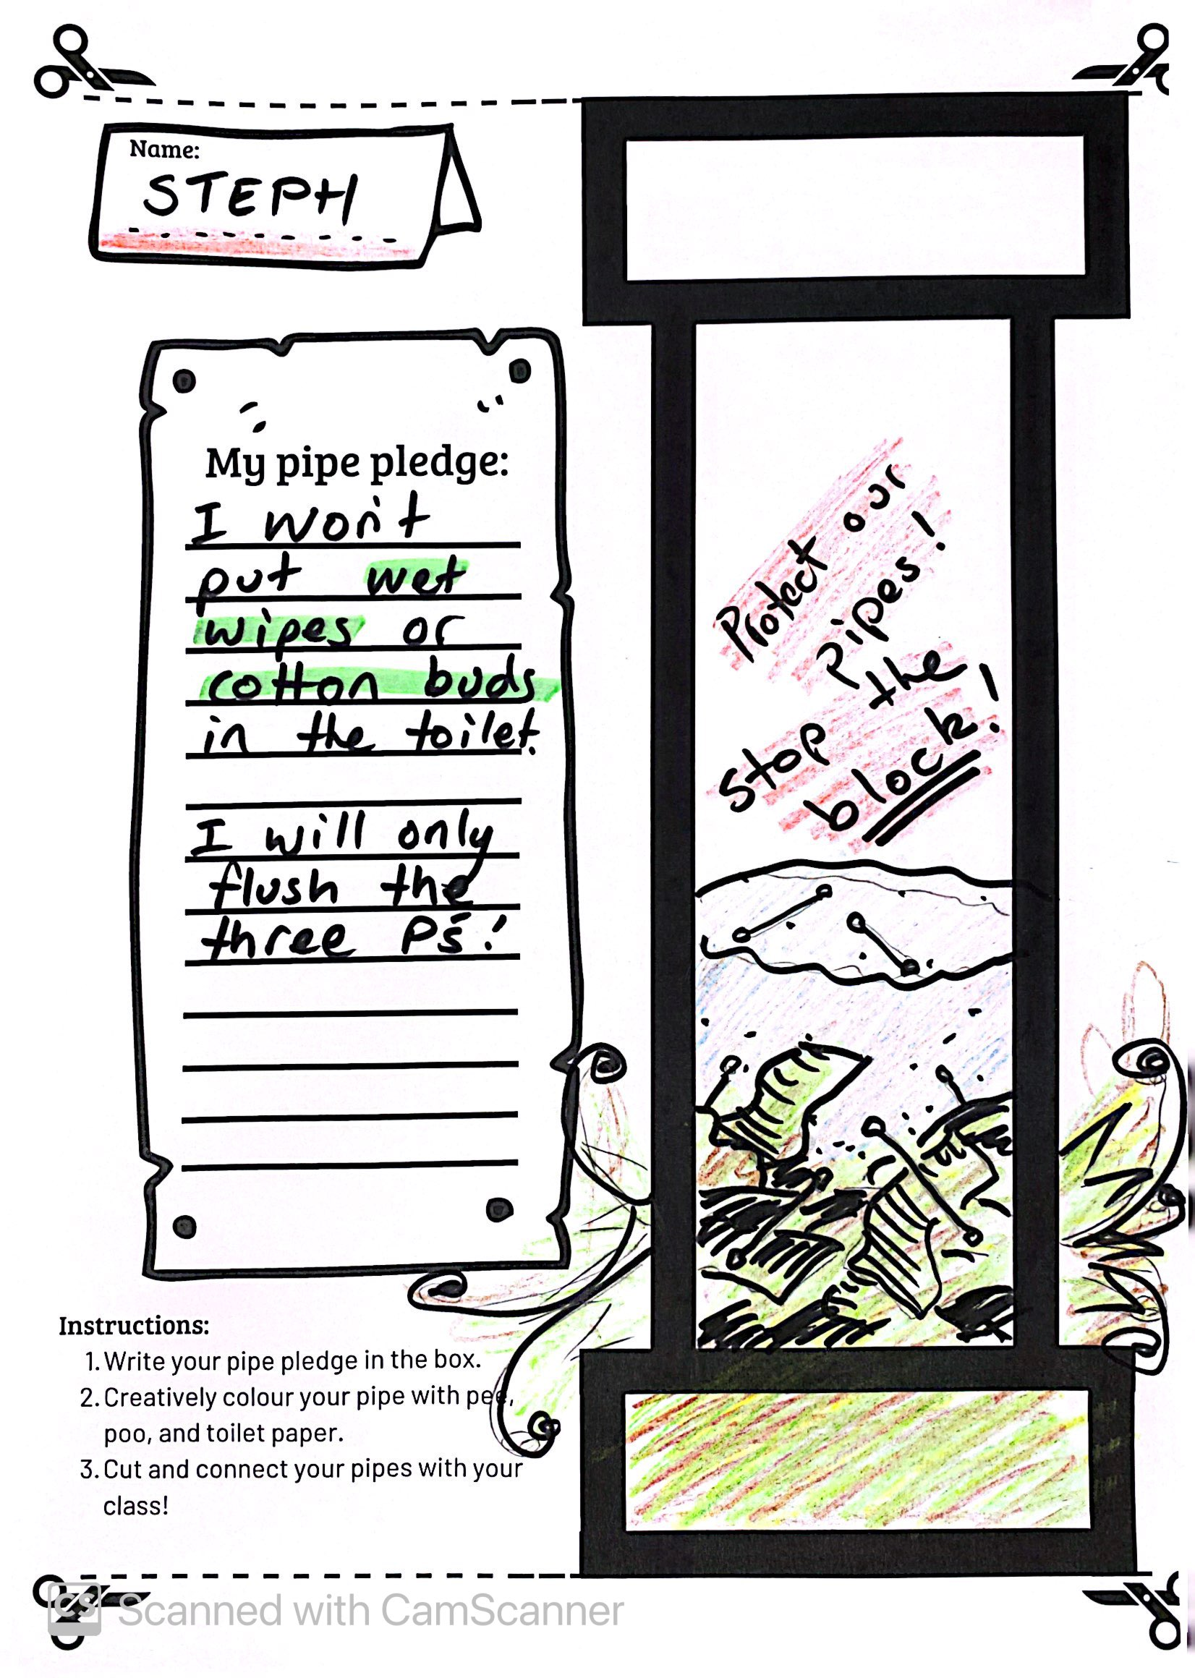
Show your learning by making a Pipe Pledge!
Your pledge should be about how you will help protect our pipes.
By looking after our pipes, we can make sure our health and the environment are protected.
Once they are all done, you can connect your class together, just like the real pipes underground.

Slide 12
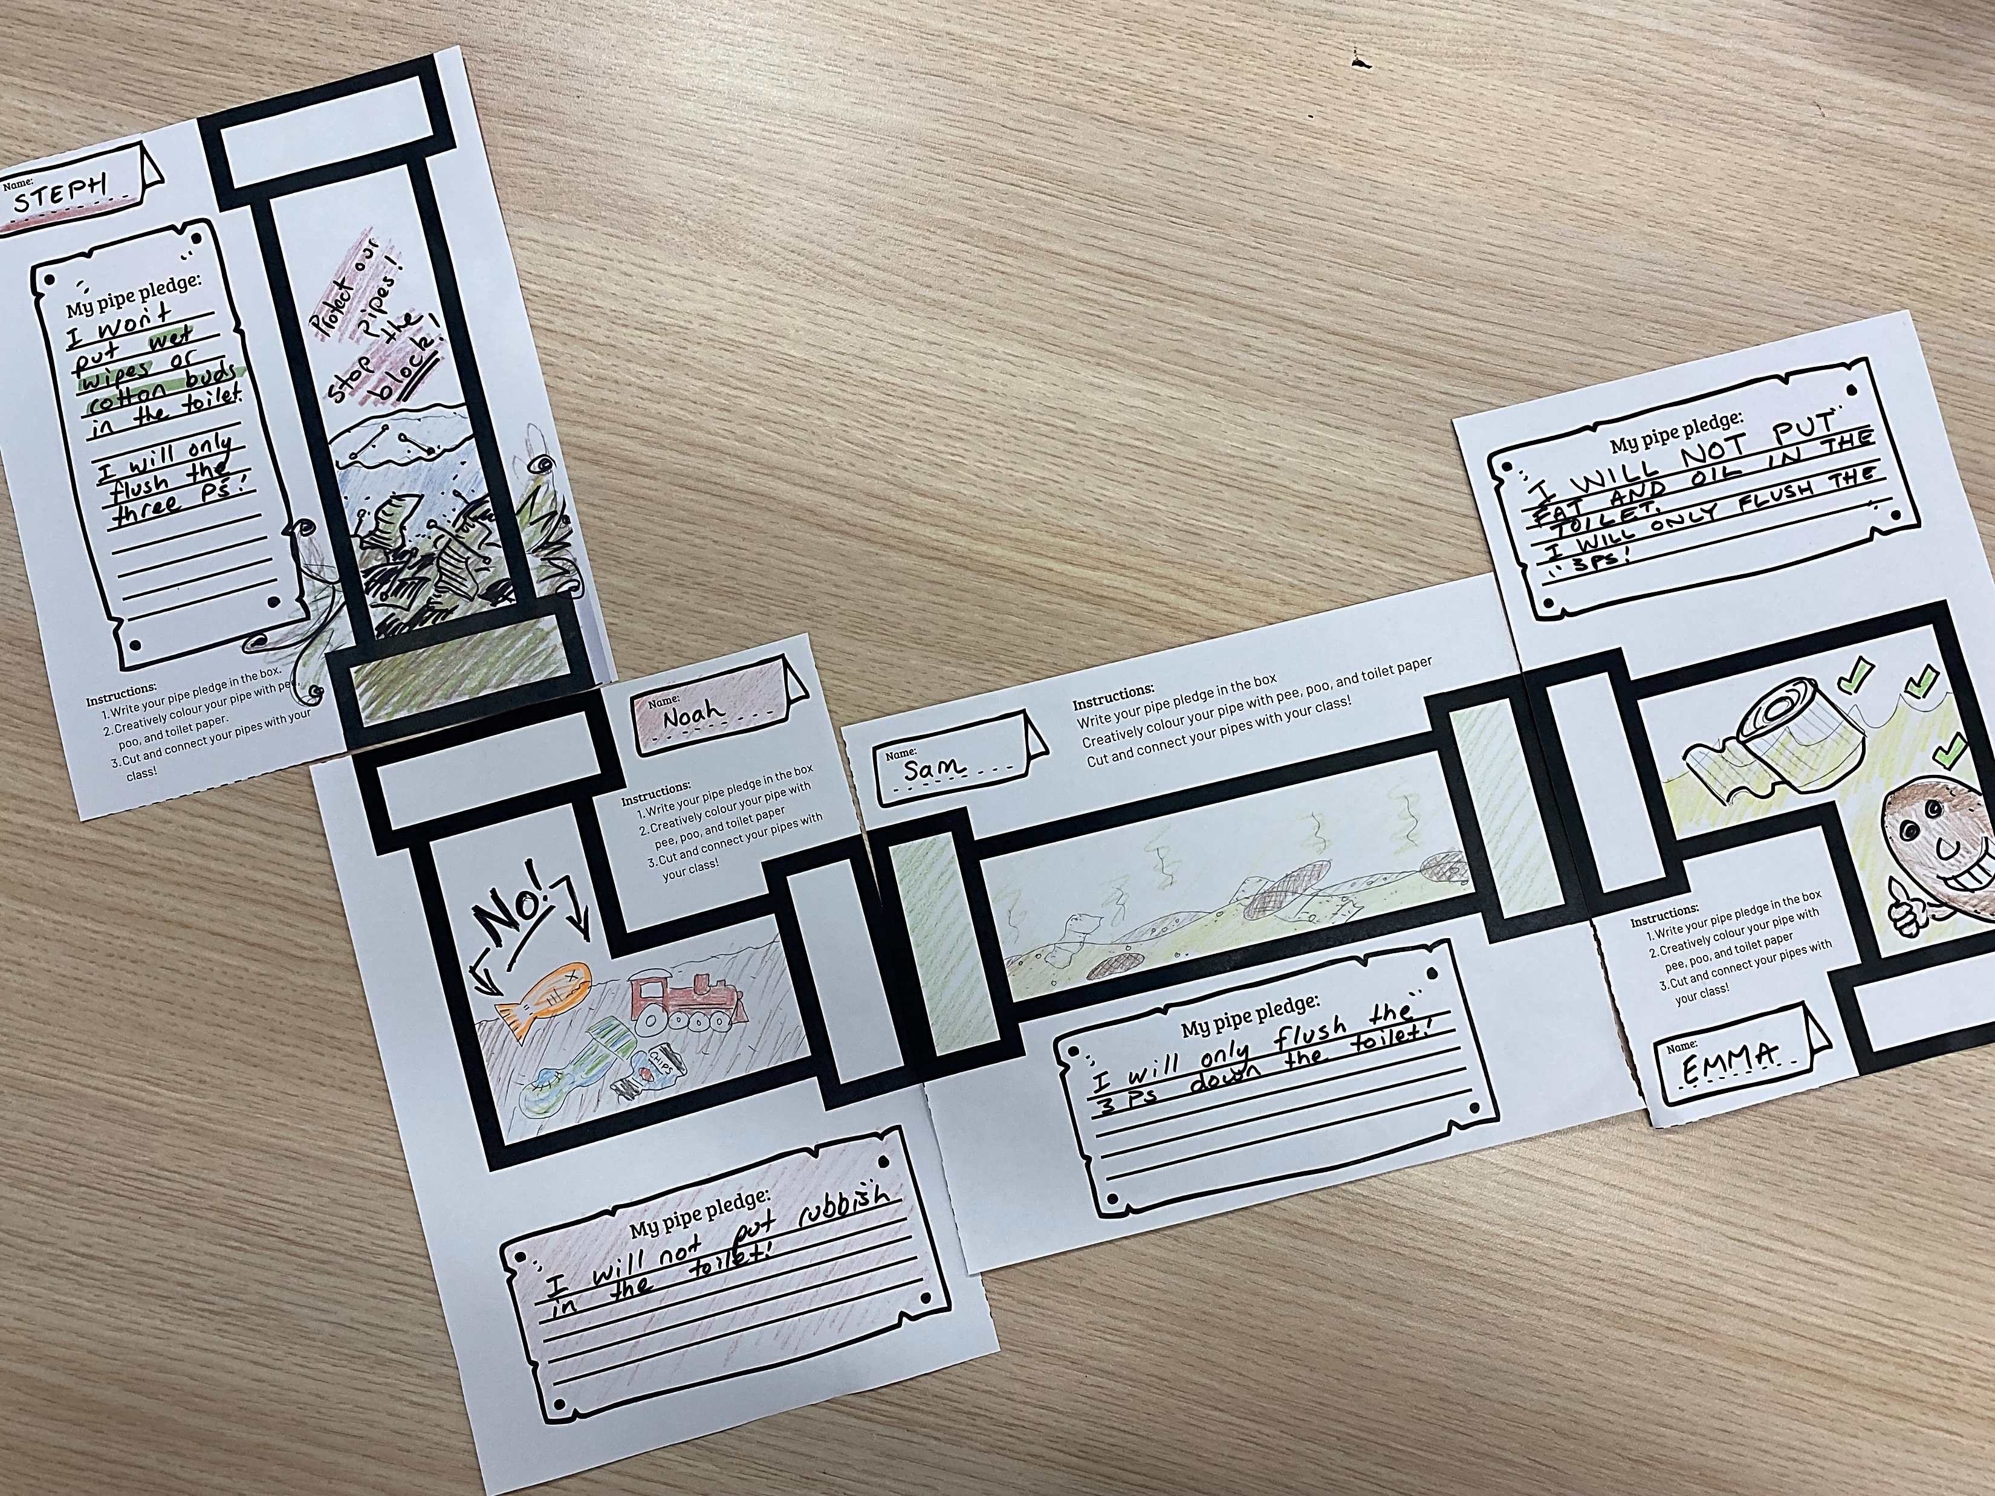
Connect them together!

Slide 13
We all create wastewater. True or False?
Quick Quiz
The three P’s are Poo, Pee and Toilet Paper. True or False?
Wet wipes can be flushed down the toilet. True or False?
You can pour chemicals down the sink. True or False?
Fats and oils should not be poured down the sink? True or False?
Our sewage pipes are all connected? True or False?

Slide 14
We all create wastewater. True or False?
Quick Quiz
Answers
True
The three P’s are Poo, Pee and Toilet Paper. True or False?
True
Wet wipes can be flushed down the toilet. True or False?
False
You can pour chemicals down the sink. True or False?
False
Fats and oils should not be poured down the sink? True or False?
True
Our sewage pipes are all connected? True or False?
True

Slide 15
Thank you!
Flushed!

